Slide 1



1
COD892: MTP1
Network Traffic Analysis
Guide : Prof. Vireshwar Kumar & Prof. Tarun Mangla
29th Sept 2024
By : Sajal Verma & Manish Kumar
[2023MCS2490] [2023MCS2497]

Slide 2

OVERVIEW
A surge in the diversity and volume of network traffic, with more and more applications & devices such as IoTs devices connected to internet.
presents significant challenges in network management and security.
i.e., security monitoring & policy enforcement.
ML approaches in network traffic classification, particularly deep learning models have shown significant results in the classification of network streams.
We propose a Transformer based approach for Network Traffic characterization & application identification.
2

Slide 3
LITERARY REVIEW
Three main previously used methods (port-based, payload-based, time-stamp/size based statistical methods in ML) aren’t that effective, given we have encrypted data nowadays, also these require explicit feature extraction which is prone to human error & time consuming[1].
Although, CNNs excels at identifying spatial dependencies, i.e., they can detect patterns that represents specific types of headers, or sequences within packets.
LSTM can capture temporal dependencies in sequential data[4], i.e., they can identify patterns that indicate a sequence of actions or behavior across multiple packets.
Deep Packet
LSTM
3
Notes:
p

Slide 4
4
PROBLEM STATEMENT
We’ve been working on the ISCX-VPN-NonVPN dataset.
To classify the network stream into various protocol classes & applications.
Following this,
We’ll use the captured Network stream within our organization, to classify it appropriately & evaluate the proposed model’s accuracy.
OBJECTIVES
To efficiently process and classify large volumes of network data using Transformers from raw encrypted packet data.
Extracts features crucial for classifying network traffic into predefined categories.

Slide 5
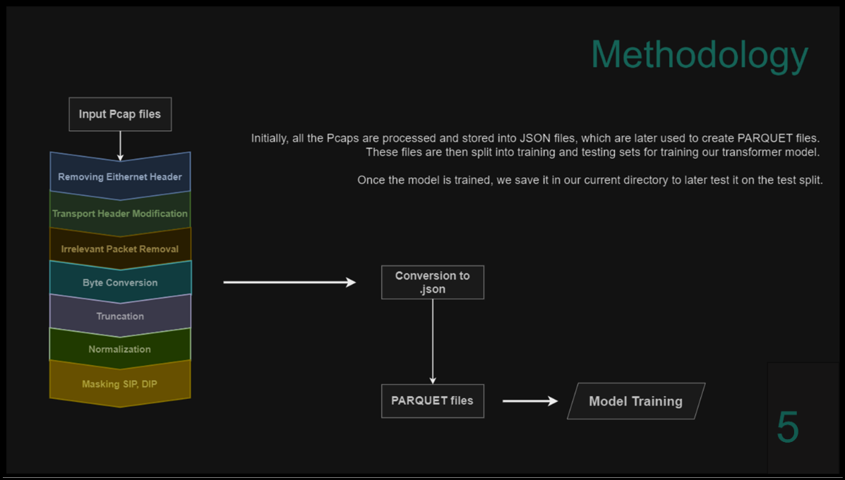

Slide 6
Transformer architecture
Input
Vector of 1500 bytes → Embedding → Positional Encoding.
Transformer Encoder
6 layers of multi-head attention + feed-forward.
Output
Fully connected layer for application/traffic classification and uses softmax for classification
Loss & Optimization
Cross-entropy loss + Adam optimizer + StepLR.
6

Slide 7
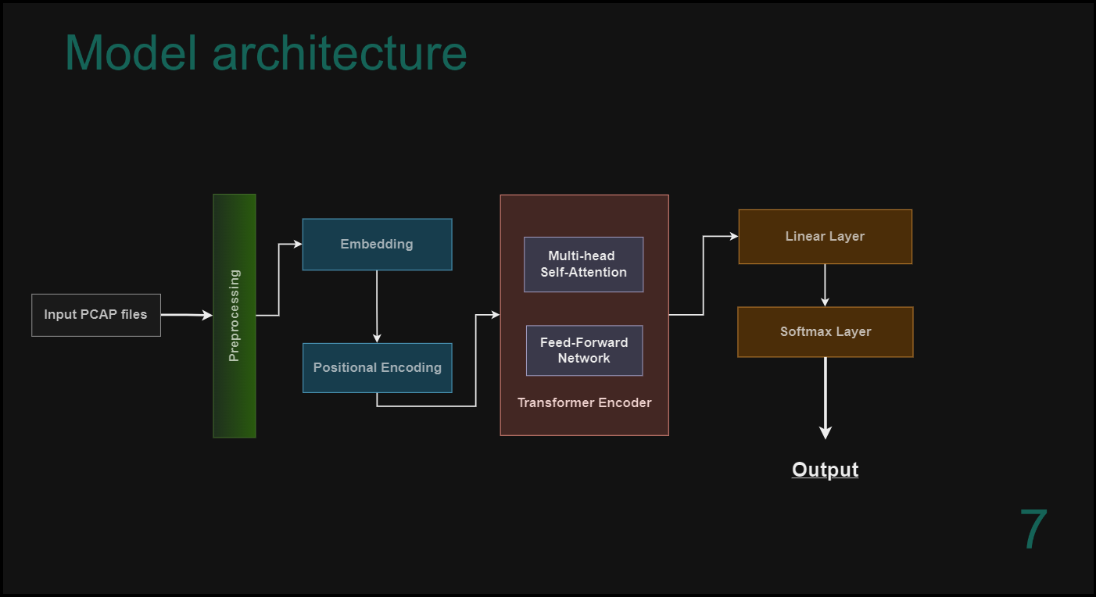

Slide 8
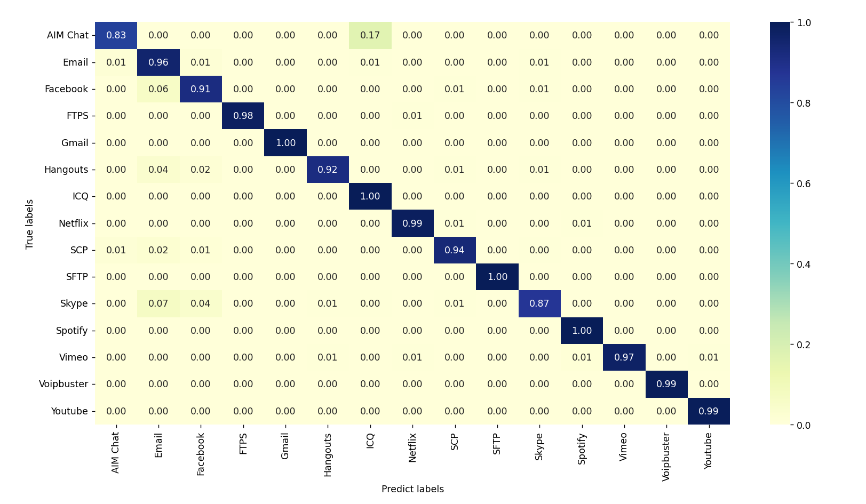
CONFUSION Matrix
8
Application Identification

Slide 9
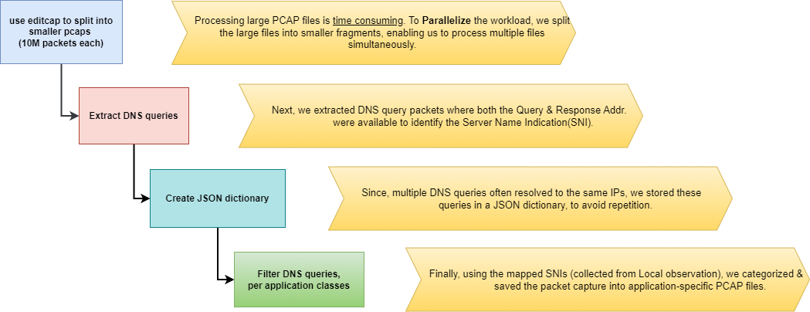
Labelling IITD Traffic
9

Slide 10
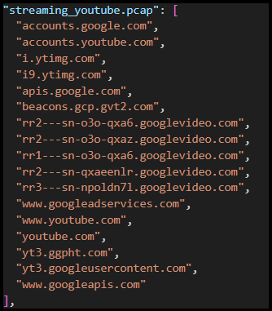
SNI Data Segregation
10
Identify Major classes from DNS queries responses
Captured Traffic & gather available SNI info.
Save this information to reuse later.
Filtered extraneous SNI info., that was fetched along.

Slide 11

Following major classes were identified from IITD traffic to categorize packets into classes :
Utility | Application Class
Streaming | YouTube
 | Netflix
 | Spotify
 | PrimeVideo
Facebook | Messaging
 | Browsing
Github
Microsoft | Teams
 | OneDrive
WhatsApp | Calls, messaging
LinkedIn
DropBox | Upload/download files
E-commerce | Amazon
 | Flipkart
Google | Browsing/Ads
some classes will be refined in more detailed
Result
11

Slide 12


12
Minor
Literature Review
Paper implementation
Model Proposal
Application Classification result : 93.25%
(we’ve had used ISCX-VPN-NonVPN dataset earlier)
Future Work (MTP1 & 2)
Identify major classes from Internal traffic
Split traffic stream into appl. Classes (partially done)
Set ground labels & train Model
Verify accuracy on Realtime data

Slide 13
REFERENCES
[1] Lotfollahi, M., Jafari Siavoshani, M., Shirali Hossein Zade, R., & Saberian, M. (2020). Deep packet: A novel approach for encrypted traffic classification using deep learning. Soft Computing, 24(3), 1999-2012.
[2] Zou, Z., Ge, J., Zheng, H., Wu, Y., Han, C., & Yao, Z. (2018, June). Encrypted traffic classification with a convolutional long short-term memory neural network. IEEE 16th International Conference on Smart City; IEEE 4th International Conference on Data Science and Systems (HPCC/SmartCity/DSS) (pp. 329-334). IEEE.
[3] Finsterbusch M, Richter C, Rocha E, Muller JA, Hanssgen K (2014) A survey of payload-based traffic classification approaches. IEEE Commun Surv Tutor 16(2):1135–1156
[4] Hwang, R. H., Peng, M. C., Nguyen, V. L., & Chang, Y. L. (2019). An LSTM-based deep learning approach for classifying malicious traffic at the packet level. Applied Sciences, 9(16), 3414. [16]Sun, P., Liu, P., Li, Q., Liu, C., Lu, X., Hao, R., & Chen, J. (2020). DL-IDS: Extracting features using CNNLSTM hybrid network for intrusion detection system. Security and communication networks, 2020, 1-11.

Slide 14


THANK YOU!
mcs232490@iitd.ac.in
mcs232497@iitd.ac.in https://github.com/MKumar-12/COD892-Classification-of-network-stream-into-Application-data

